Slide 1
Advanced Computer Architecture & Advanced Microprocessor System
Name:
Index #: 20121748
Session: Morning/Evening
LAB # (Up-down counter with Sync Reset)

Slide 2
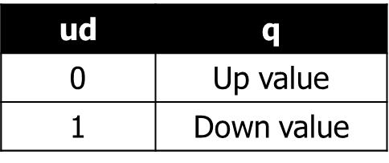
Up-down Counter with Sync Reset
Circuit Diagram
Block Diagram
bit3updown
DFF0
d
clk
clk
●
clk
q
3
reset
●
reset
reset
q
DFF1
ud
●
d
●
clk
q
●
●
reset
DFF2
●
d
clk
q
●
q[2:0]
reset
Adder
3’h1

Slide 3
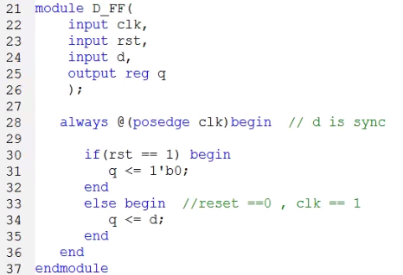
Up-down counter with sync Reset
D_FlipFlop (Synchronize reset )
source
Reset signal is active on the posedge of the clock

Slide 4
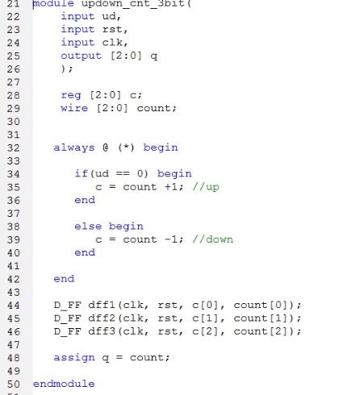
Up-down Counter with Sync Reset
source

Slide 5
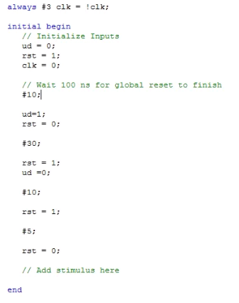
Up-down Counter with Sync Reset
Test bench

Slide 6

Up-down Counter with Sync Reset
Simulation Waveform
When rst = 1, the q value is initialized at the next positive edge of the clock.

